Slide 1

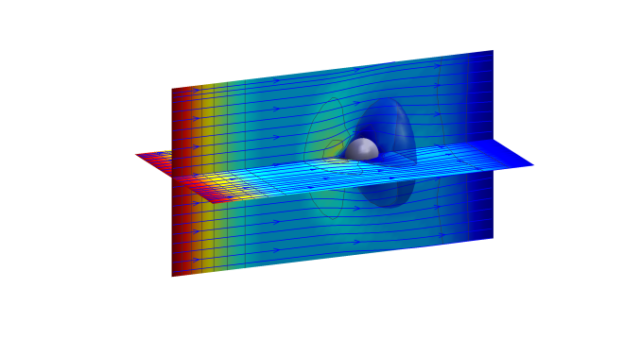
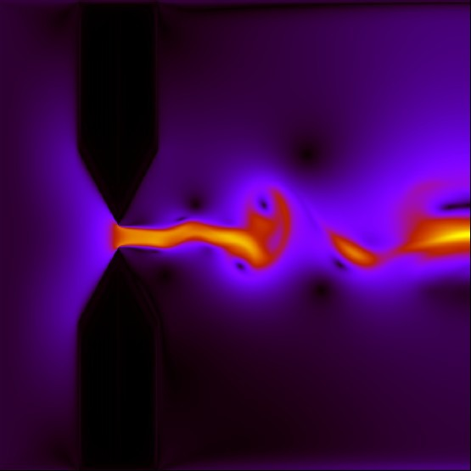
An Overview on Relativistic Lattice Boltzmann Models
By: Miller Mendoza Jiménez
Collaborations: Hans Herrmann, Sauro Succi, Farhang Mohseni, Oliver Furtmaier, David Ottinger, Ilario Giordanelli, Ilya Karlin, Paul Romatschke, Ekin Ilseven, Alessandro Gabbana, Raffaele Tripiccione.
ETH Zurich, Switzerland
Notes:
/home/mmendozaj/ETH-design/presentation-openoffice/template_praesentation_oo.odp

Slide 2
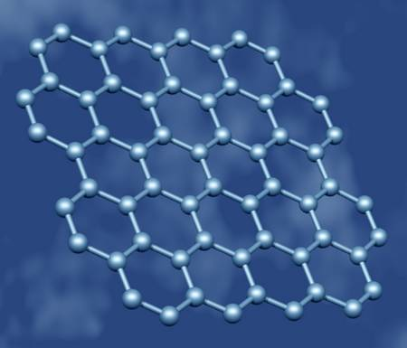
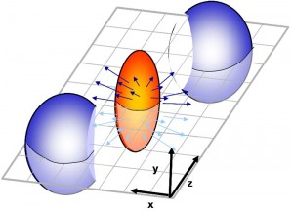
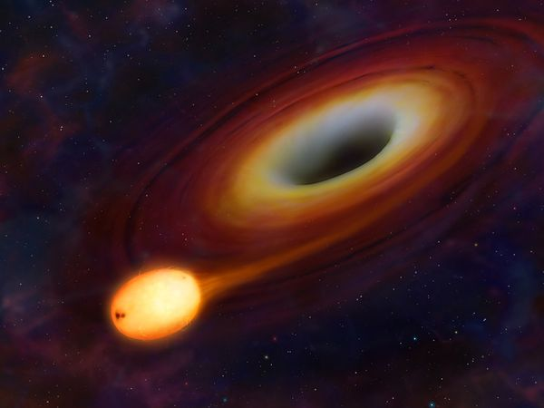
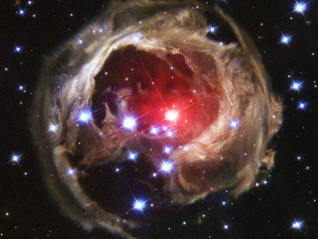
Relativistic Fluid Dynamics
Quark-gluon plasma
Electronic flow in graphene
Au
Au
^{J.} _{Appl.} ^{Phys. 64, 6365 (1988).}
Gravity – fluid dynamics
Supernovae

Slide 3
Why?: Relativistic Navier-Stokes Equations
Number of particles
Energy conservation
Precise dissipation tensors is unknown
Number density
Fluid velocity
Energy-momentum conservation
Pressure
Lorentz’s factor
Energy density
Correction term

Slide 4
Why Boltzmann equation level?
The nonlinearity effects are intrinsically included in the Boltzmann equation.
All the information of the system is content in the particle distribution functions.
It is a hyperbolic equation, in contrast with the Relativistic Navier-Stokes equations, which are parabolic, and therefore violate causality.

Slide 5
Relativistic Kinetic Theory

Slide 6
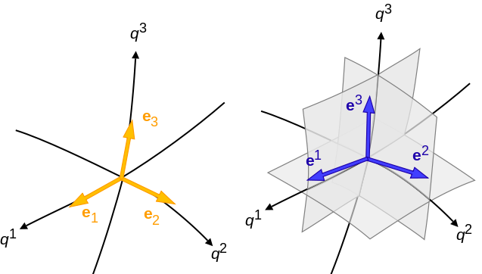
First of all: Working with contravariant components of vectors
Metric tensor

Slide 7
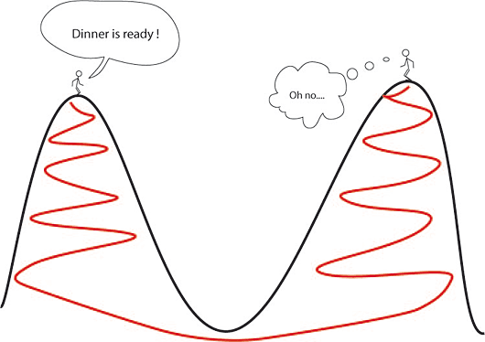
Measure of the distance
Two infinitesimally separated points
Two separated points, is an arbitrary parameter, and is the trajectory joining them.

Slide 8
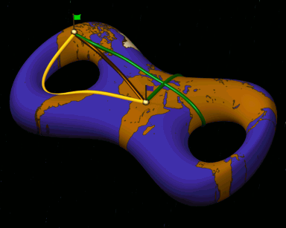
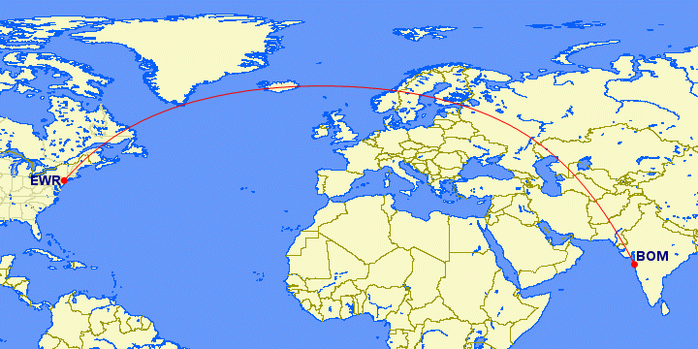
Geodesics: Shortest path
Geodesic equation:
For a particle:
Geodesic equation contains
Non-inertial forces:

Slide 9
Relativistic Boltzmann Equation
Particles 4-Momentum
Note: Momentum is used instead of velocity because velocity is not a relativistic invariant, e.g. electromagnetism.
Particle momentum
Particle energy

Slide 10
Relativistic Boltzmann Equation
Analogy with non-relativistic gas, the relativistic Bhatnagar-Gross-Krook (BGK).
Marle Model (1965)
Anderson and Witting Model (1974)
Mildly relativistic fluids
Ultrarelativistic

Slide 11
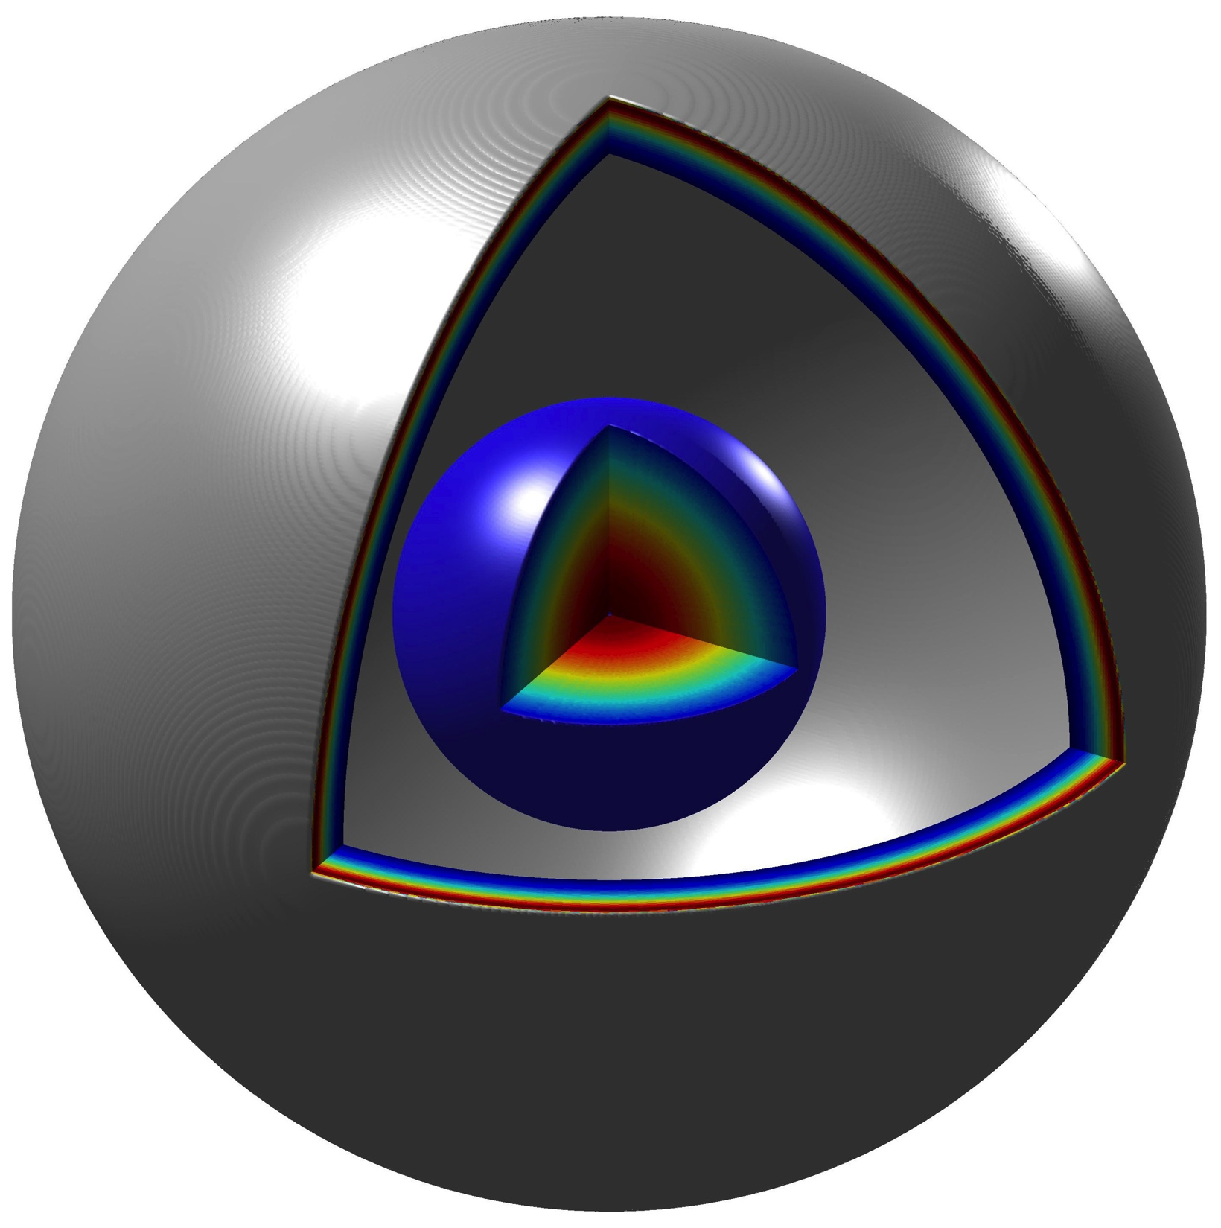
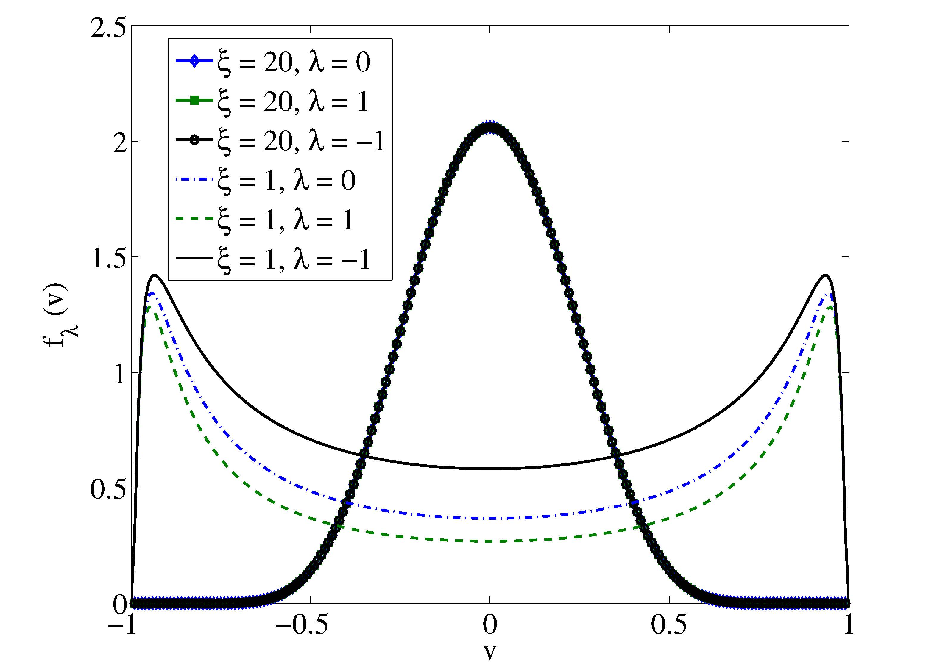
Equilibrium Distribution in velocity space
1D
3D
M. Mendoza et al., Scientific Reports 2, 611 (2012).

Slide 12
Maxwell-Jüttner Distribution
In thermodynamic equilibrium the relativistic Boltzmann Equation has a solution for the distribution function: The Maxwell-Jüttner distribution:
No Hermite expansion and no separable in Cartesian coordinates.
No Gaussian shape:
P. Romatschke et al., Physical Review C 84, 034903 (2011).
By default, not a lattice friend. However, matching of the moments of the distribution is possible!!

Slide 13
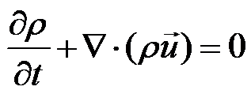
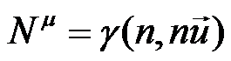
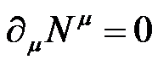
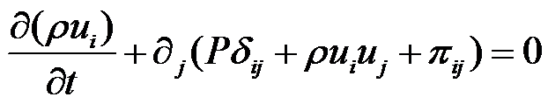
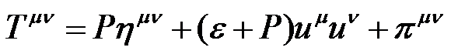
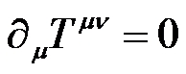
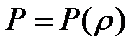
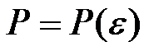
Relativistic Hydrodynamics
Non-relativistic fluids
Relativistic fluids
Conservation of mass
Conservation of particle number
Momentum conservation
Energy and momentum conservation
Equation of state
Equation of state

Slide 14
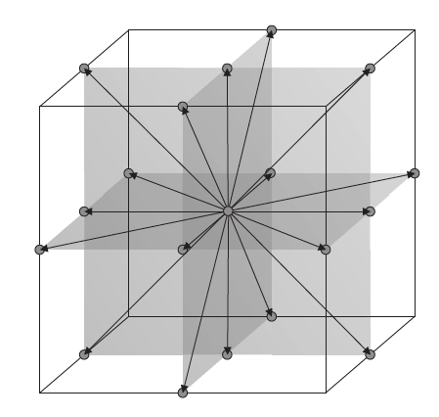
Answer: Matching of the moments
Writing the equilibrium distributions as functions of Lagrange multipliers:
M. Mendoza et al., Physical Review Letters 105, 014502 (2010).
M. Mendoza et al., Physical Review D 82, 105008 (2010) .

Slide 15
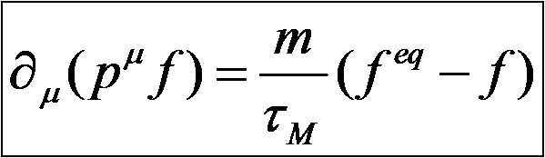
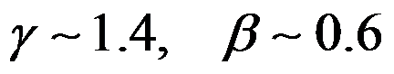
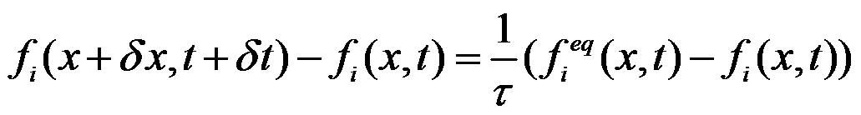
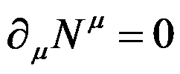
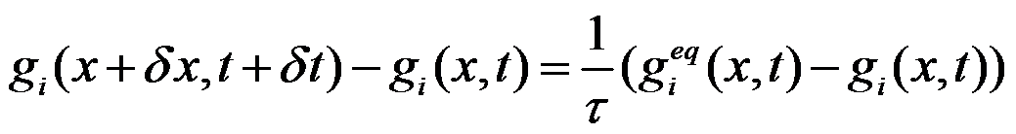
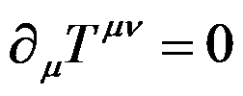
Relativistic Lattice Boltzmann
Weakly relativistic: Marle Model
4-dimensional system
M. Mendoza et al., Physical Review Letters 105, 014502 (2010).
M. Mendoza et al., Physical Review D 82, 105008 (2010) .

Slide 16
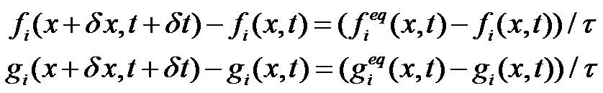
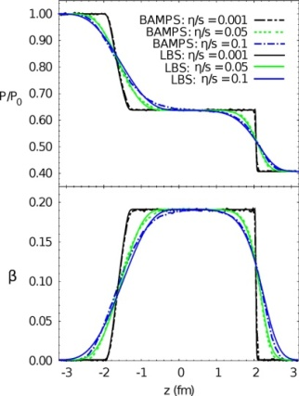
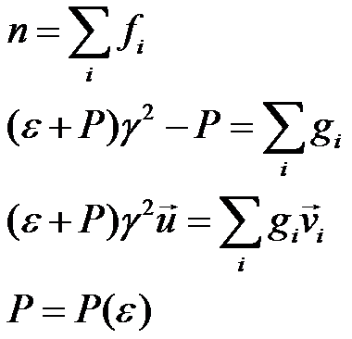
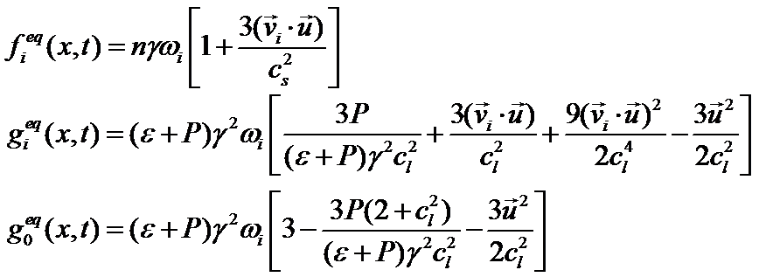
Relativistic Lattice Boltzmann Method
Macroscopic variables:
Equilibrium distribution function:
M. Mendoza et al., Physical Review Letters 105, 014502 (2010).
M. Mendoza et al., Physical Review D 82, 105008 (2010) .

Slide 17
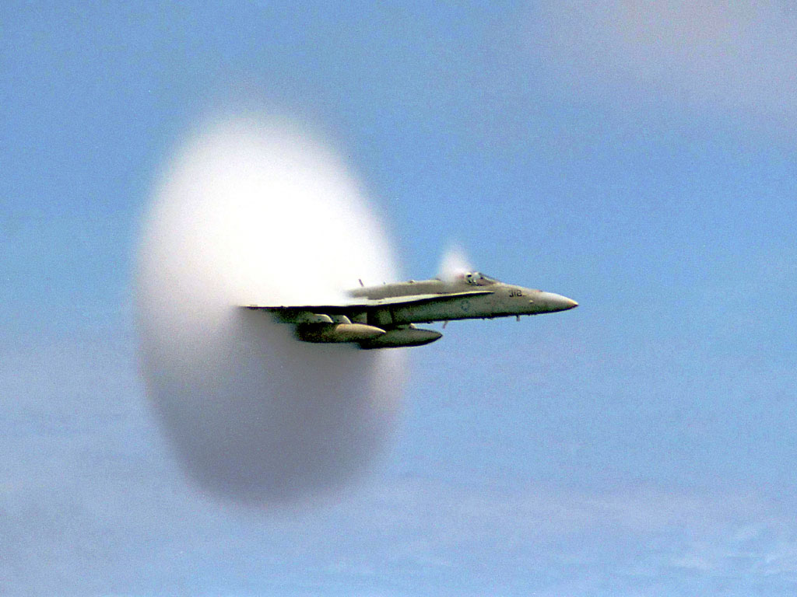
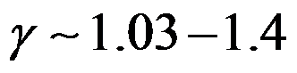
Validation with Quark-Gluon Plasma
Existence of Shock waves open the idea of considering the quark-gluon plasma as a fluid.
I. Bouras, E. Molnar, H. Niemi, Z. Xu, A. El, O. Fochler, C. Greiner, and D. H. Rischke, Phys. Rev. Lett. 103, 032301 (2009).
P. Romatschke, Int. J. Mod. Phys. E 19, 1 (2009).
H. Stöcker, Nucl. Phys. A750, 121 (2005); J. Ruppert and B. Müller, Phys. Lett. B 625, 123 (2005); J. Casalderrey-Solana, E.V. Shuryak, and D. Teaney, J. Phys. Conf. Ser. 27, 22 (2005); V. Koch, A. Majumder, and X. N. Wang, Phys. Rev. Lett. 96, 172302 (2006).
Au
Au
Parton

Slide 18

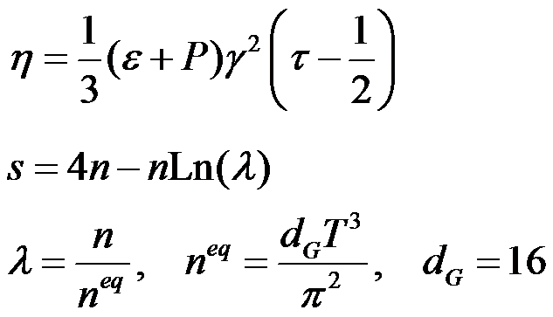
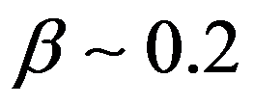
Validation with Quark-Gluon Plasma
Ratios of time consumption:
1:20:80000 (single CPU)
For RLB : vSHASTA : BAMPS
BAMPS: Boltzmann Approach of Multi-Parton Scattering.
M. Mendoza et al., Physical Review Letters 105, 014502 (2010).
M. Mendoza et al., Physical Review D 82, 105008 (2010) .

Slide 19
An application on Graphene
Novoselov, K. S. et al. Proc. Natl Acad. Sci. 102, 10451–10453 (2005).
Novoselov, K. S. et al. Science 306, 666–669 (2004).

Slide 20
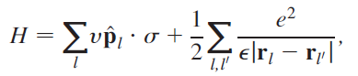
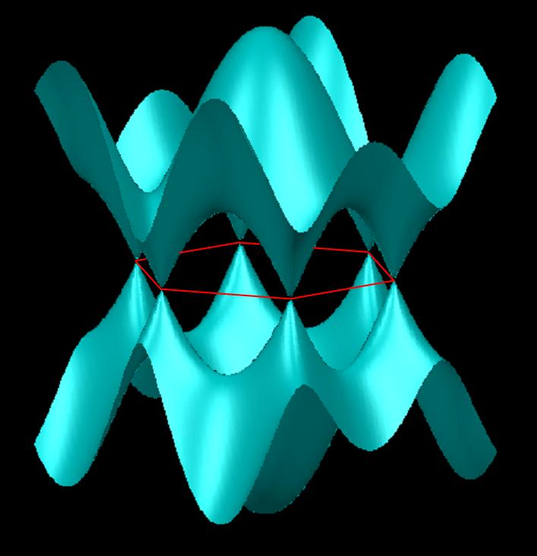
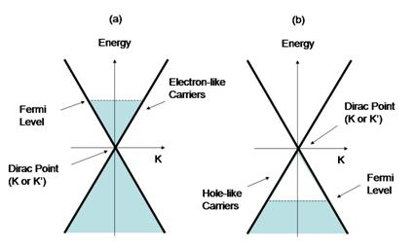
Electronic Flow in Graphene
M. Müller et al. Phys. Rev. Lett. 103, 025301 (2009)
kT

Slide 21
Electronic Flow in Graphene
M. Müller et al. Phys. Rev. Lett. 103, 025301 (2009)
From Dirac equation to Quantum Boltzmann Equation
In equilibrium:

Slide 22
Electronic Flow in Graphene
In equilibrium:
The carrier density comes from thermal excitations:
M. Müller et al. Phys. Rev. Lett. 103, 025301 (2009)

Slide 23
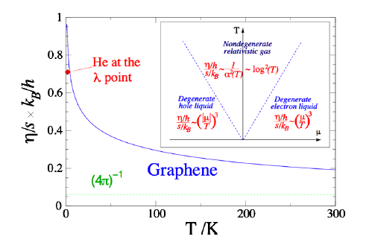
Turbulence in Graphene. Can it be measured?
Quasiperfect fluid
It can be important to:
Study of turbulence itself.
Control electrical current fluctuations in electronic devices.
M. Müller et al. Phys. Rev. Lett. 103, 025301 (2009)

Slide 24
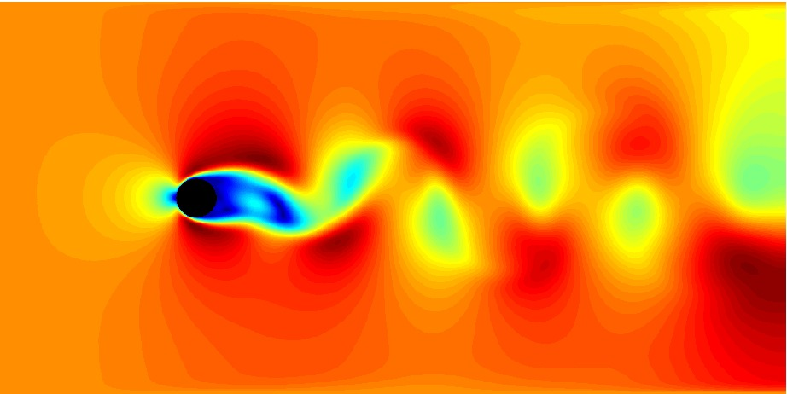
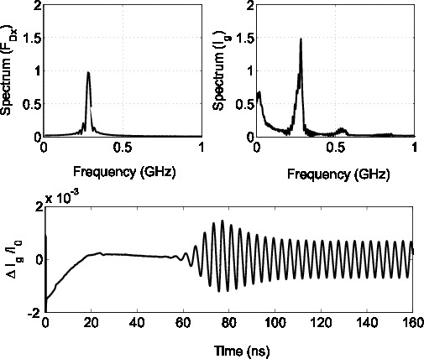
Results with RLB in graphene
Re = 100
L = 5 μm
u_{typ} = 10⁵ m/s
M. Mendoza et al., Physical Review Letters 105, 014502 (2010).
M. Mendoza et al., Physical Review Letters 106, 156601 (2011).

Slide 25
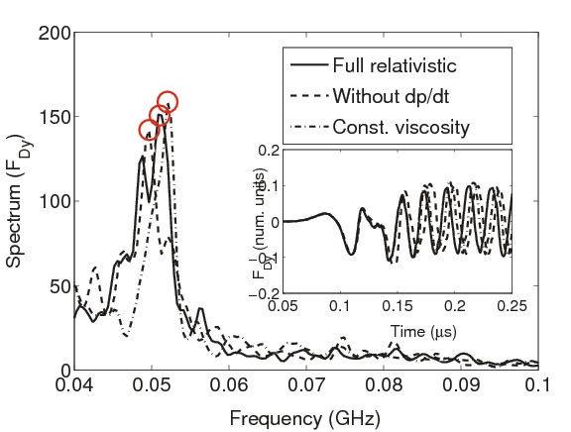
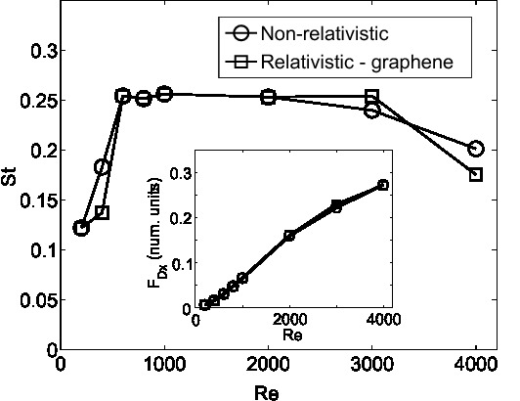
Preturbulence in Graphene. Relativistic Effects
Shift in the vortex shedding frequencies
Re = 3000
St: Strouhal number (Adimensional vortex shedding frequency)
M. Mendoza et al., Physical Review Letters 105, 014502 (2010).
M. Mendoza et al., Physical Review Letters 106, 156601 (2011).

Slide 26
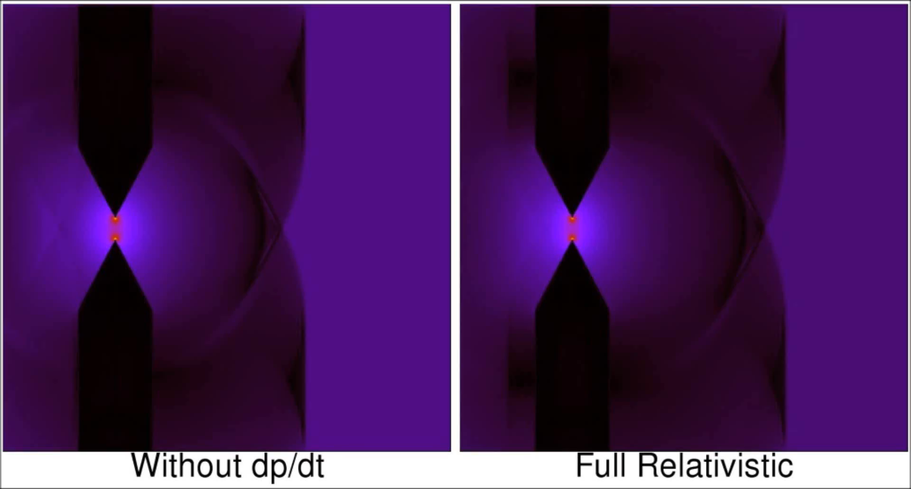
Changing the geometry allows preturbulence at Re = 25
M. Mendoza et al., Physical Review Letters 105, 014502 (2010).
M. Mendoza et al., Physical Review Letters 106, 156601 (2011).

Slide 27
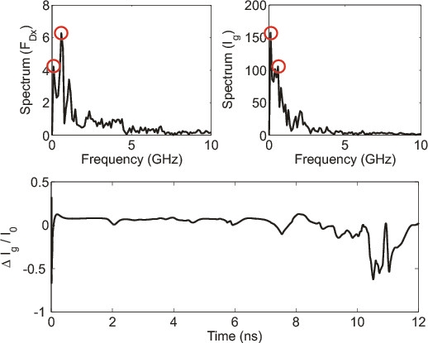
The frequencies corresponding to the vortices could be detected experimentally.
Re = 25
L = 1.25 μm
u_{typ} = 10⁵ m/s
M. Mendoza et al., Physical Review Letters 105, 014502 (2010).
M. Mendoza et al., Physical Review Letters 106, 156601 (2011).

Slide 28
Relativistic Lattice Boltzmann
2 distributions, is it possible to use 1?

Slide 29
Fully relativistic lattice Boltzmann models

Slide 30
Model 1

Slide 31
Fully relativistic lattice Boltzmann models
Ultrarelativistic limit, m = 0
Use of vectorial and Laguerre orthogonal polynomials
P. Romatschke et al., Physical Review C 84, 034903 (2011).

Slide 32
Landau-Lifshitz decomposition
Anderson-Witting collision operator:
Solve the eigenvalue problem:
And then the density:
P. Romatschke et al., Physical Review C 84, 034903 (2011).
M. Mendoza et al., Phys. Rev. D 87, 065027 (2013)

Slide 33
Relativistic Boltzmann Equation
For the case of ultra-relativistic particles:
P. Romatschke et al., Physical Review C 84, 034903 (2011).
M. Mendoza et al., Phys. Rev. D 87, 065027 (2013)

Slide 34
Fully relativistic lattice Boltzmann models. Model 1
Advantages:
It is the first fully relativistic LB model based on Gauss-quadrature.
One single distribution function carries all the information of the fluid.
Disadvantage:
Velocity vectors with spherical symmetry do not fill the space, and therefore, we need interpolation to calculate values at the nodes.
P. Romatschke et al., Physical Review C 84, 034903 (2011).

Slide 35
Model 2

Slide 36
Relativistic Distribution: Polynomials
In thermodynamic equilibrium the relativistic Boltzmann Equation has a solution for the distribution function:
M. Mendoza et al., Phys. Rev. D 87, 065027 (2013)
Polynomials

Slide 37
Relativistic Distribution: Polynomials
In thermodynamic equilibrium the relativistic Boltzmann Equation has a solution for the distribution function:
Anderson-Witting Model
M. Mendoza et al., Phys. Rev. D 87, 065027 (2013)

Slide 38
Relativistic Distribution: Polynomials
For the case of ultra-relativistic particles:
M. Mendoza et al., Phys. Rev. D 87, 065027 (2013)

Slide 39
Relativistic Distribution: Polynomials 3D
384 momentum vectors, 96 velocity vectors
For 3rd order accuracy
90 momentum vectors, 30 velocity vectors
For 2nd order accuracy
M. Mendoza et al., Phys. Rev. D 87, 065027 (2013)

Slide 40
Relativistic Distribution: Polynomials 2D
18 momentum vectors,
6 velocity vectors
For 2nd order accuracy
M. Mendoza et al., Phys. Rev. D 87, 065027 (2013)
D. Öttinger et al. Phys. Rev. E 88, 013302 (2013)

Slide 41
Relativistic Lattice Boltzmann
M. Mendoza et al., Phys. Rev. D 87, 065027 (2013)

Slide 42
Relativistic Lattice Boltzmann
M. Mendoza et al., Phys. Rev. D 87, 065027 (2013)

Slide 43
Rayleigh–Bénard Instability in Graphene

Slide 44

Rayleigh–Bénard Instability
T₁ < T₂
q
T₂
Heat is transported via convection instead of conduction.
https://www.youtube.com/watch?v=5ApSJe4FaLI

Slide 45
Rayleigh–Bénard Instability. Linear Stability
Standard Rayleigh number non-relativistic (buoyancy/viscous forces):
?
O. Furtmaier et al., Phys. Rev. B 91, 085401 (2015)

Slide 46
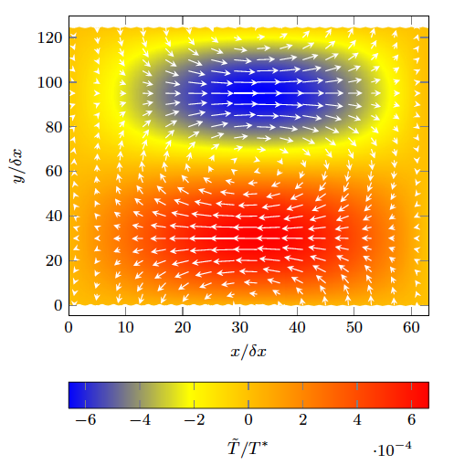
Rayleigh–Bénard Instability in Graphene
Rayleigh number in Graphene:
Achieving that critical Rayleigh number currently
is challenging:
O. Furtmaier et al., Phys. Rev. B 91, 085401 (2015)

Slide 47
Fully relativistic lattice Boltzmann models: Main Drawback
Dissipation is accurately known only if one recovers up to 5th order of the equilibrium distribution. Going to a lattice that supports the 5th order moment, implies larger number of vectors with spherical symmetry (More interpolation for Model 1, and loss of resolution for Model 2).
M. Mendoza et al., Journal of Statistical Mechanics: Theory and Experiments 2, P02036 (2013).

Slide 48
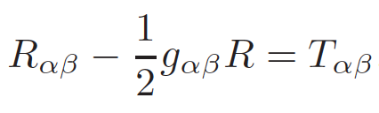
General Relativity. Theory of Gravity
Einstein equation:
Particle motion
Energy tensor, also contains mass
Fluid motion

Slide 49
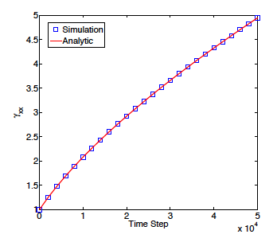
General Relativity. Lattice Boltzmann
Set of 10 hyperbolic equations
It works by using a distribution function for each hyperbolic equation. Is it possible to use one?
First we need to think on a kinetic theory of gravity.
Expanding universe solution.
E. Ilseven and M. Mendoza, Phys. Rev. E 93, 023303 (2016).

Slide 50
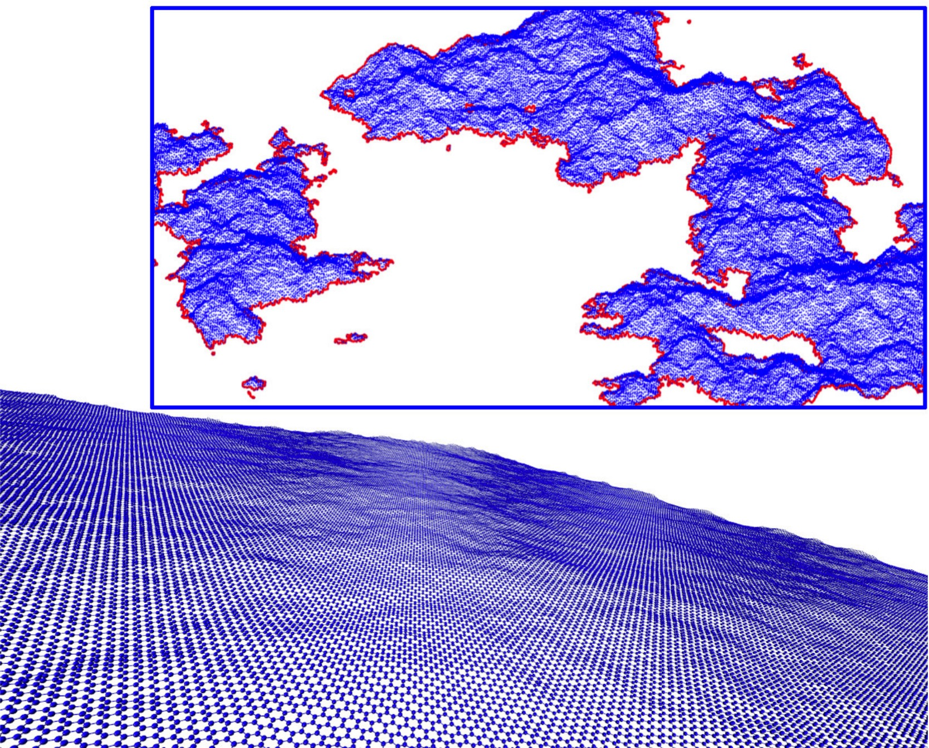
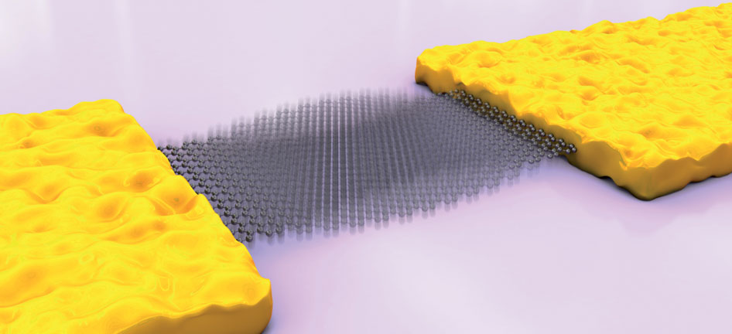
Geometrical representation of phonons
Electron-phonon interactions at room temperature.
Image: Nature Nanotechnology 6, 331–332 (2011)

Slide 51



Geometrical representation of phonons
Giordanelli, I., Mendoza, M., & Herrmann, H. (2017). arXiv preprint arXiv:1702.04156.

Slide 52
Take home message. Algorithms
Relativistic lattice Boltzmann model with applications in quark-gluon plasma, supernova explosions, and electronic flow in graphene.
The RLB is four orders of magnitude faster than others relativistic kinetic models.
Complex geometries in relativistic systems can be treated with easy, specially in graphene applications.
More sophisticated RLB model have also been proposed in order to improved dissipation and other problems of the first RLB.
Is it possible to develop a RLB for higher order moments without loss of resolution?
What about discretization effects?

Slide 53
Take home message. Physics
Vortex phenomena can produce notable electrical current fluctuations due to contact points and /or constrictions in graphene samples.
Rayleigh-Bénard instability could appear in future samples larger than 100 μm, causing electrical noise and/or temperature fluctuations due to heat convection.
Is it possible to model electron-phonon interactions in graphene via Christoffel Symbols?
Is there a kinetic theory of general relativity?

Slide 54

Thank you for your attention!!

